Slide 1
Predicting Housing Prices Based on Job Factors
Understanding the Link Between Employment and Real Estate in California
Presenter: Donn Bryan Julian Date: 10/15/2024

Slide 2
Project Overview
The objective of this project was to predict housing prices in California based on job-related factors.
We aimed to understand how employment opportunities, income levels, and housing characteristics influence the affordability of homes.
The analysis combines housing data with career data to uncover key insights for policymakers, real estate developers, and the general public.

Slide 3
Datasets Used
Housing Data: Median age, rooms, bedrooms, population, households, median income, house value, and location.
Job Data: Job listings, job titles, salary ranges, work type, and locations (focused on Alameda and Contra Costa counties).
By merging these datasets, we gained insights into the relationship between employment opportunities and housing affordability.

Slide 4
Data Cleaning Steps
Filtered job data to focus on Alameda and Contra Costa counties for localized analysis.
Removed duplicate job listings to ensure accuracy.
Created a unified "Location" column in the housing data to align with the job dataset.
Extracted salary range values into "min_salary" and "max_salary" columns for analysis.

Slide 5
Analytical Approach
One-Hot Encoding was applied to categorical features like job types and department names for machine learning purposes.
We experimented with various regression models, including Linear Regression, Random Forest, Gradient Boosting, and CatBoost, to predict median house values.
Feature importance analysis was used to understand the significance of each predictor.

Slide 6
Model Results
Several models showed near-perfect R² scores, indicating strong predictability, but this was largely influenced by data complexity.
Reinforcement Learning techniques were used to optimize model blending for higher accuracy, resulting in an R² of 0.91 during cross-validation.

Slide 7
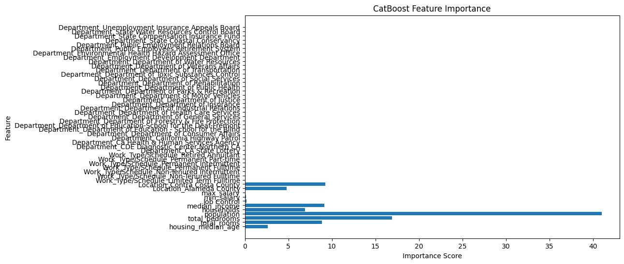
Key Drivers of Housing Prices
CatBoost Model Insights: Median Income and Population were highly significant predictors.

Slide 8
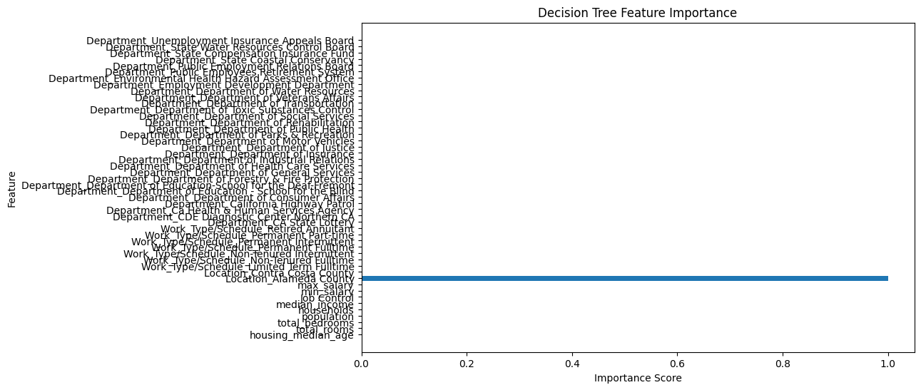
The Decision Tree model identified Households as the most significant feature in predicting housing prices. This reflects the Decision Tree's simple splitting mechanism, focusing on features that provide clear distinctions in the data. However, the model's limited complexity may overlook subtle relationships between other features and housing prices.

Slide 9
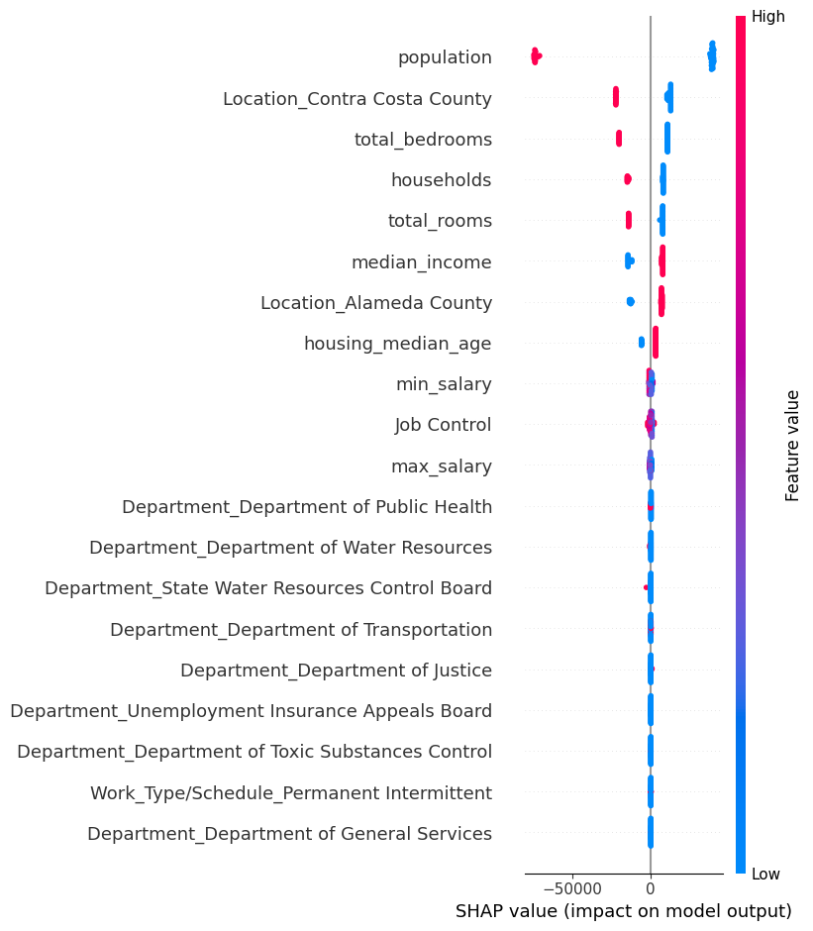
SHAP Analysis
SHAP Analysis:
The SHAP summary plot highlighted the influence of features like Population, Location, and Total Bedrooms on housing prices, providing deeper interpretability of the model's decisions.

Slide 10
Findings
Economic factors like Median Income play a key role in determining housing affordability.
Job-related factors like location (e.g., Contra Costa County) also have a measurable impact.
Population and the number of available rooms are significant drivers of home values, potentially indicating market demand.

Slide 11
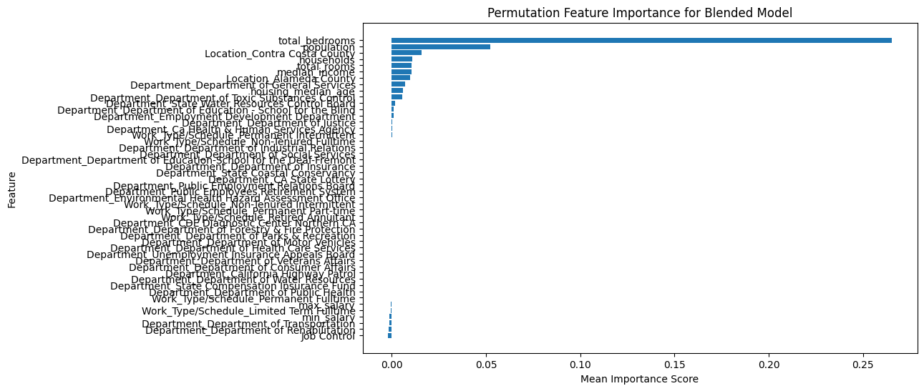

Slide 12
Project Challenges
The dataset was limited to Alameda and Contra Costa counties, restricting broader generalizability.
Potential data quality issues, such as missing values and duplicates, may have influenced model predictions.
Overfitting concerns, especially with simpler models like Decision Trees.

Slide 13
Final Takeaways
Housing prices in California are highly influenced by a combination of economic and employment-related factors.
Predictive models can help inform decision-making for homebuyers, policymakers, and urban planners.
This work emphasizes the need for more integrated data to drive decisions about housing and economic development.

Slide 14
Looking Ahead
Expand analysis to other counties in California for a more comprehensive view.
Incorporate more job characteristics, such as job satisfaction or commuting distances, to enrich the analysis.
Explore other machine learning models or deeper neural networks for potentially improved predictions.

Slide 15
Closing Remarks
This project provided valuable insights into the link between job factors and housing affordability.
The findings can contribute to informed decisions in housing policy, urban planning, and economic development.
Thank you for your attention, and we welcome any questions or thoughts on how we can further expand this analysis.

Slide 16
Questions?

